Slide 1


Bhagwan Arihant Institute of Technology
Internship on PHP Laravel framework
Internal Guide:- Dharmesh Purani
External Guide:- Gaurav Patel
Presented By:-
Soham Patel (201390107508)

Slide 2
Contents
Abstract
Company Profile
Work Plan
Glimpse of Training
Training summary
Conclusion
Future Scope
Reference

Slide 3
Abstract
The scope of this document is to identify and describe the analysis carried out, the internship completion and the experience gained as web developer intern. In this internship of PHP Laravel framework is allow you to develop a different kind of websites and webpages, which learn from the expert and also develop the webpages. Mini CRM to manage Companies and Their Employees which includes Basic Authentication, Database Design and creation in MYSQL, Create / Read / Delete and Update functionality for companies and Employees. To learn advance topic/tools related to Laravel Framework like database migration, Factory and Faker Class. This internship has allowed me to develop the skills, work habits, and attitudes needed for professional success.

Slide 4
Company Profile
Company Name : - Advait Solution.
Specialties : - Database Management, Dynamic Website, CMS Development, Php Based E-Commerce, API Integration, Cloud(Saas, Paas), CRM, Window Application
Located to :- India (Global)
Advait Solutions is an IT Consulting & Software Development team delivering end to end IT solutions to Enterprises across the globe.

Slide 5
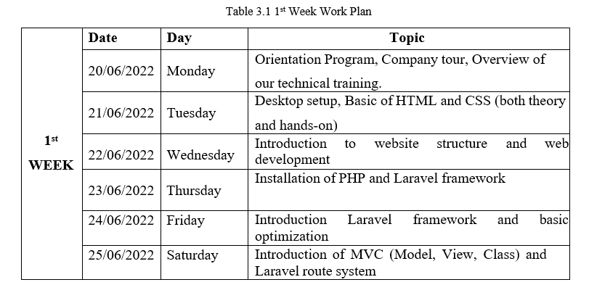
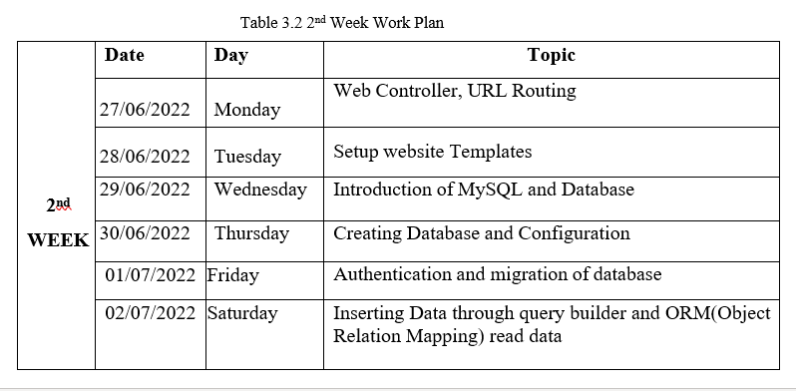
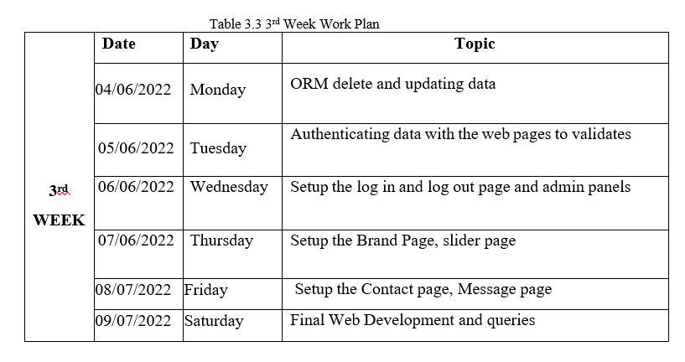
Work Plan

Slide 6
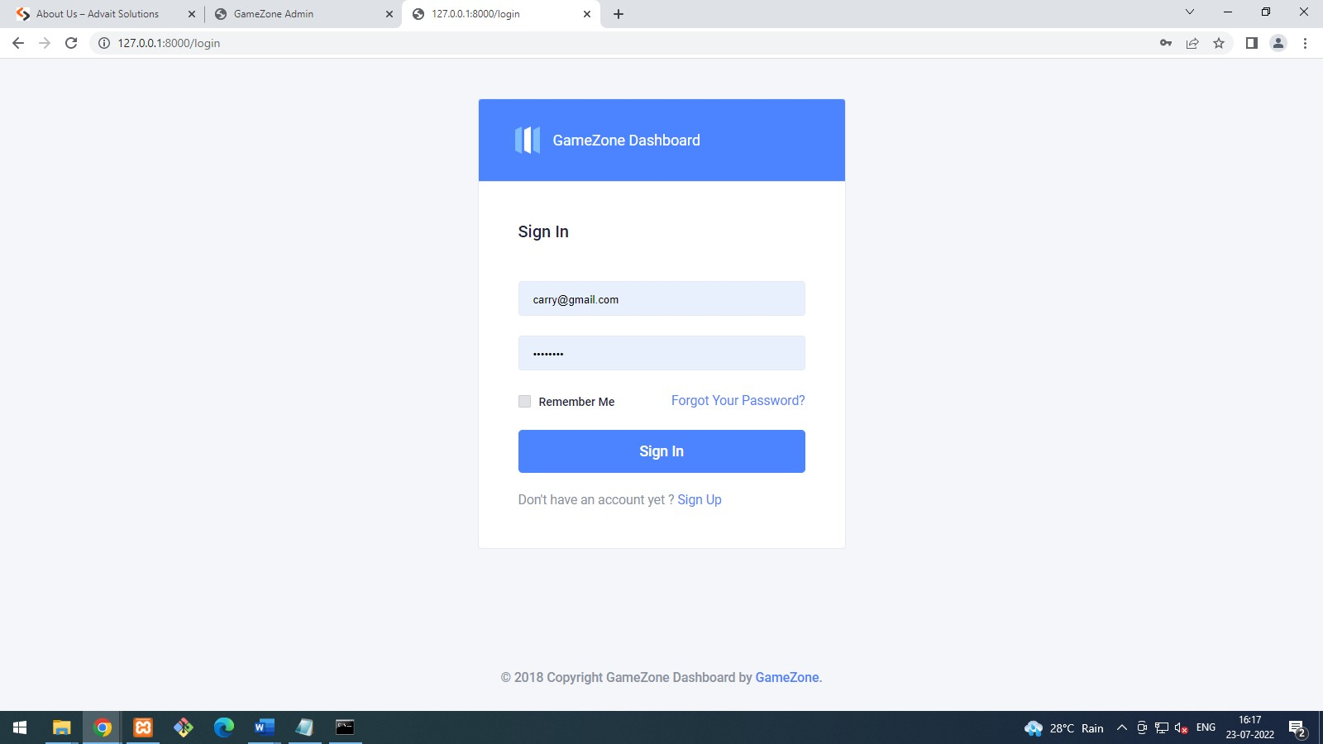
Glimpse of Project
Figure 1 : Sign In Page

Slide 7
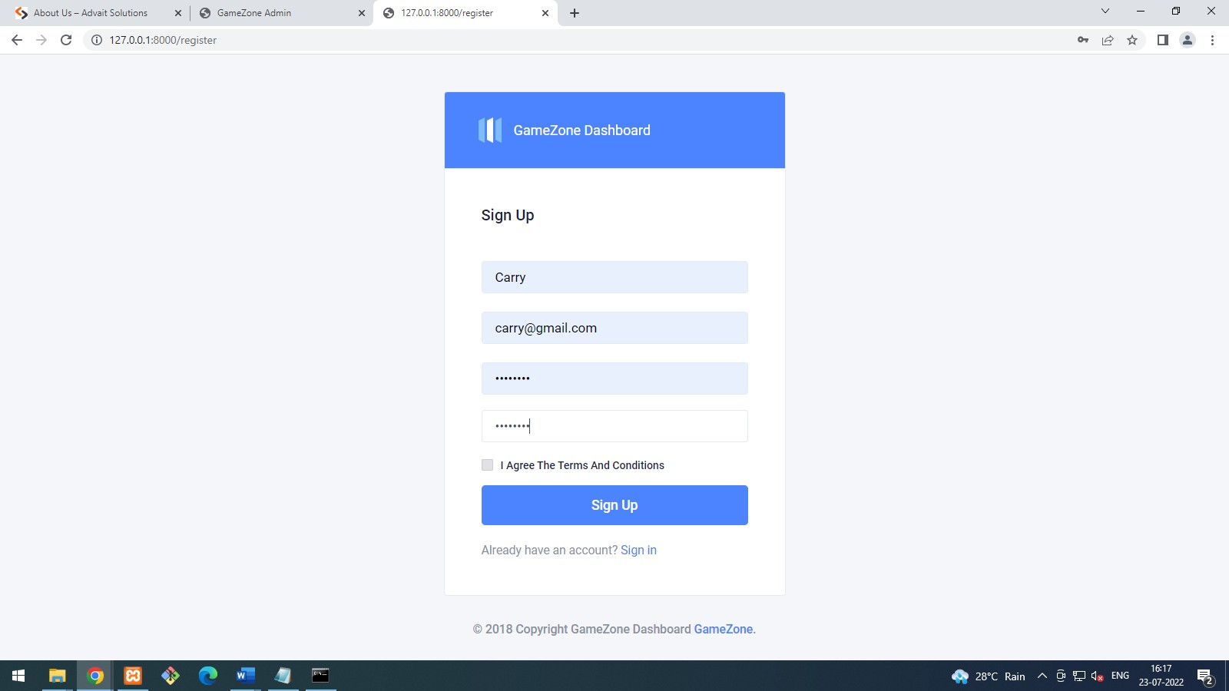
Glimpse of Project
Figure 2 : Sign Up Page

Slide 8
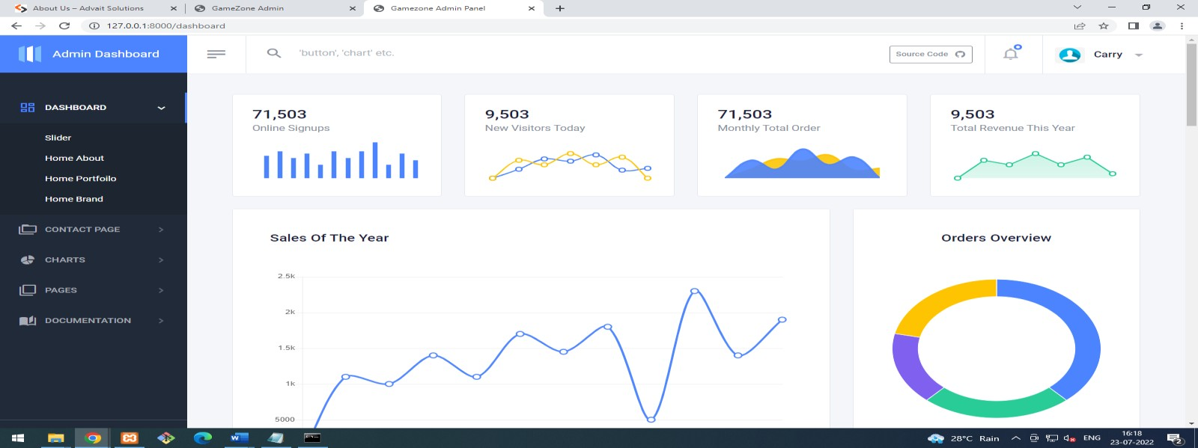
Glimpse of Project
Figure 3 : User’s Dashboard

Slide 9
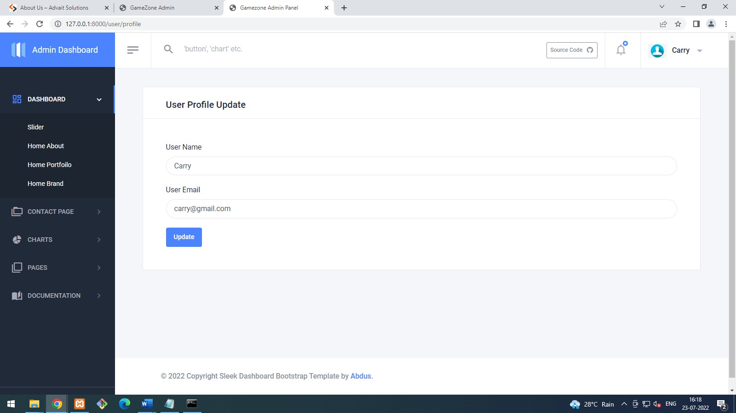
Glimpse of Project
Figure 4 : User Profile Page

Slide 10
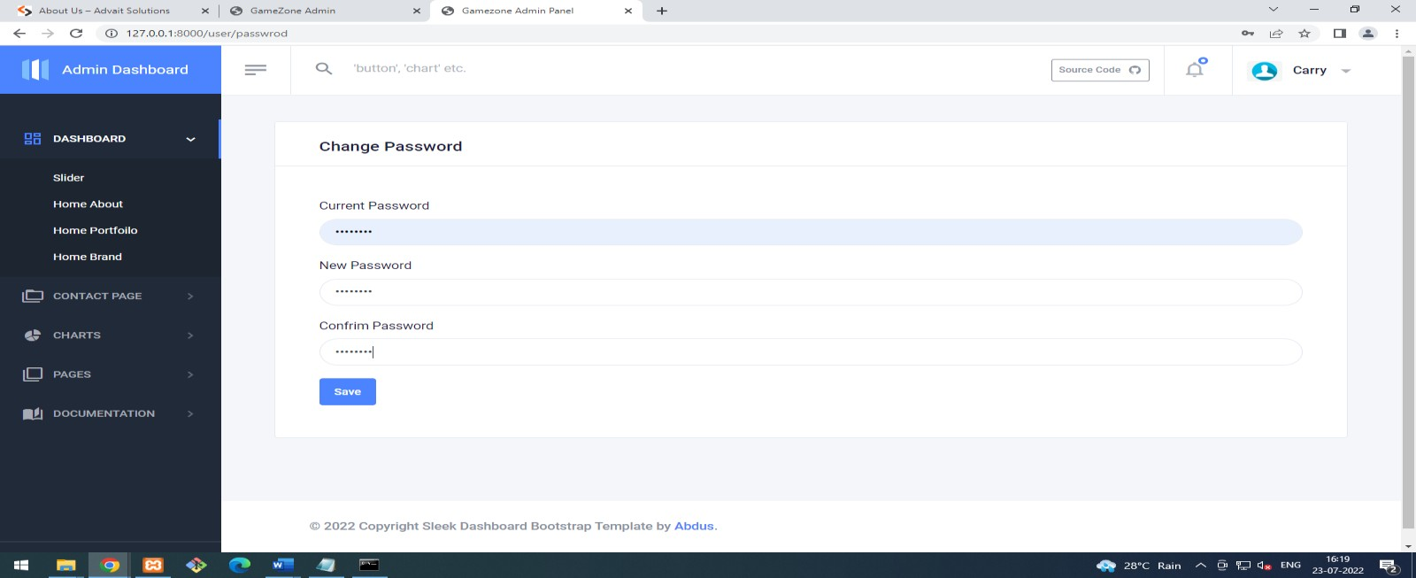
Glimpse of Project
Figure 5 : User Password Page

Slide 11
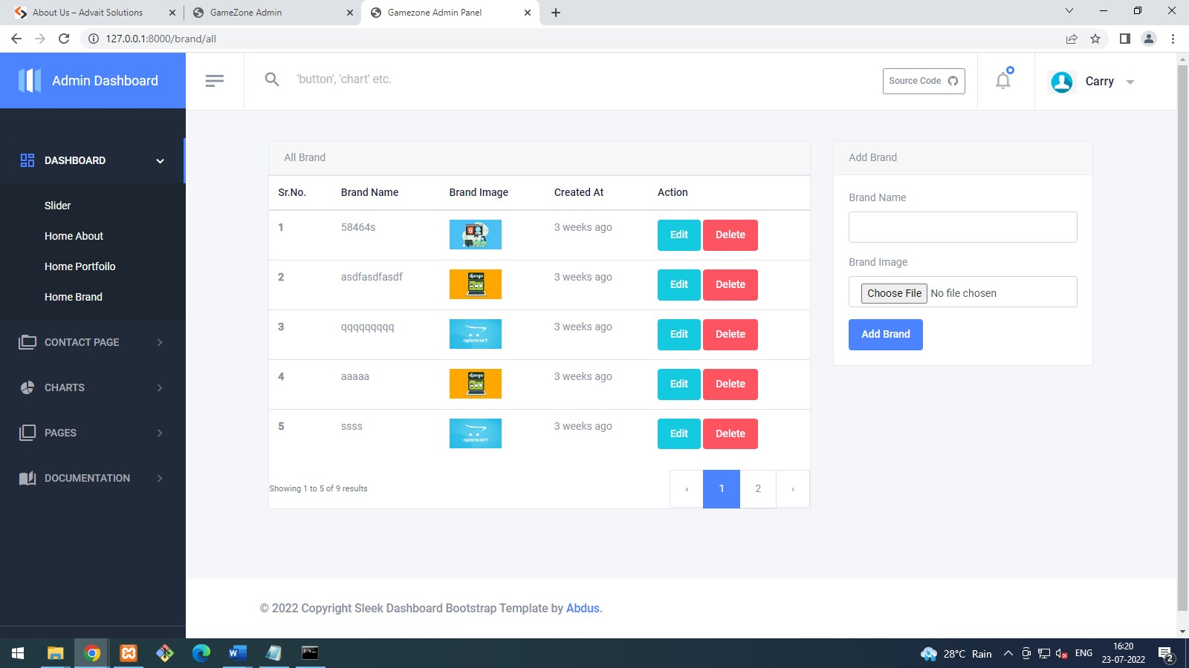
Glimpse of Project
Figure 6 : Brand Image CRUD Operation

Slide 12
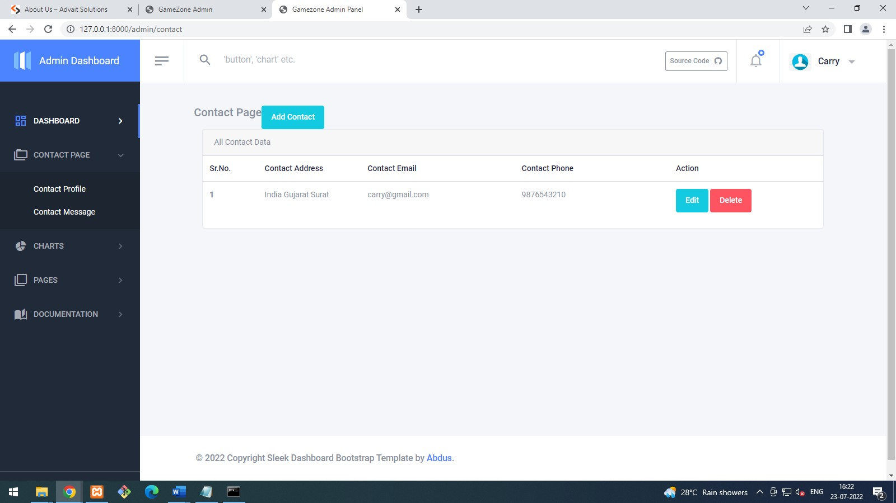
Glimpse of Project
Figure 7 : Contact Details Page

Slide 13
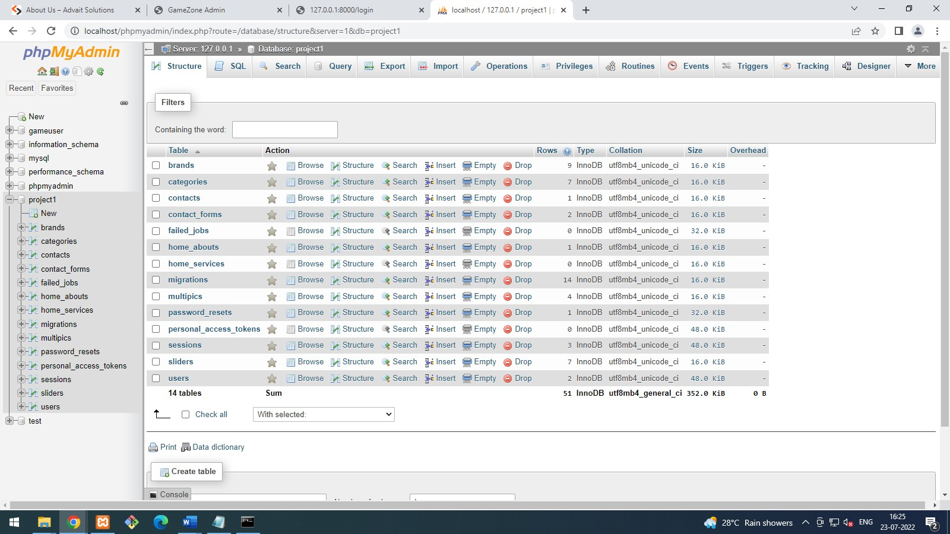
Glimpse of Project
Figure 8 : User’s Database

Slide 14
Training Summary
This internship allowed me to work in an industrial environment and be supervised by experts of that company. Throughout my time at Advait Solutions, the team has led me in every possible way from the beginning to the end. While, working on the practical implementation and I got support from both the development team and the testing team. The program offered by Advait Solution was fully structured and scheduled, every task had a complete description of learning and implementation with different milestones to complete. After the completion of each project, I performed testing of the projects, which gave me the experience of how developer side testing is carried out. Overall, the internship was very beneficial as I have improved my technical and practical knowledge along with the business skills like teamwork, time management, leadership, and a lot more.

Slide 15
Conclusion
During Internship I have learned lot of things related PHP Laravel framework. Internship at Advait Solution has been excellent experience. It helped me out to enhance and develop my soft skills. In internship I learned PHP Laravel framework and worked as a team was great experience.

Slide 16
Future Scope
Template Engine
MVC Architecture Support
Authentication and Authorization
Routing System
Eloquent Object Relational Mapping

Slide 17
References
https://laravel.com/docs/9.x/installation
https://blog.pusher.com/laravel-mvc-use/
https://www.tutorialspoint.com/html/index.htm
https://www.tutorialspoint.com/Laravel/laravel _forms.htm
https://en.wikipedia.org/wiki/HTML
https://laravel.com/docs/4.2/html

Slide 18
Thank You

